Slide 1
Strings in python

Slide 2
Strings
In python, consecutive sequence of characters is known as a string. An individual character in a string is accessed using a subscript (index). The subscript should always be an integer (positive or negative). A subscript starts from 0.

Slide 3
Example
# Declaring a string in python
>>>myfirst=“Save Earth”
>>>print (myfirst)
Save Earth

Slide 4
Working with subscripts
To access the first character of the string
>>>print myfirst[0]
S
To access the fourth character of the string
>>>print myfirst[3]
e
To access the last character of the string
>>>print myfirst[-1]
h
To access the third last character of the string
>>>print myfirst[-3]
r

Slide 5
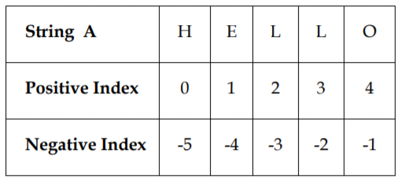
Consider the given figure

Slide 6
Important points about accessing elements in the strings using subscripts
Positive subscript helps in accessing the string from the beginning.
Negative subscript helps in accessing the string from the end.
Subscript 0 or –ve n(where n is length of the string) displays the first element.
Example : A[0] or A[-5] will display ‘H’
Subscript 1 or –ve (n-1) displays the second element.
Note: Python does not support character data type. A string of size 1 can be treated as characters.

Slide 7
Creating and initializing strings
A literal/constant value to a string can be assigned using a single quotes, double quotes or triple quotes.
Enclosing the string in single quotes
Example
>>>print (‘A friend in need is a friend indeed’)
A friend in need is a friend indeed
As shown in example 2, to include the single quote within the string it should be preceded by a backslash. Example
>>>print (‘This book belongs to Raghav\’s sister’)
This book belongs to Raghav\’s sister
As shown in example 2, to include the single quote within the string it should be preceded by a backslash.

Slide 8
Enclosing the string in double quotes
Example
>>>print (“A room without books is like a body without a soul”)
A room without books is like a body without a soul
Enclosing the string in triple quotes
Example
>>>life=“““\” Live as if you were to die tomorrow.
Learn as if you were to live forever.\”
---- Mahatma Gandhi ”””

Slide 9
>>> print life
“ Live as if you were to die tomorrow.
Learn as if you were to live forever. ”
---- Mahatma Gandhi
Triple quotes are used when the text is multiline.
In the above example, backslash (\) is used as an escape sequence. An escape sequences is nothing but a special character that has a specific function. As shown above, backslash (\) is used to escape the double quote.

Slide 10
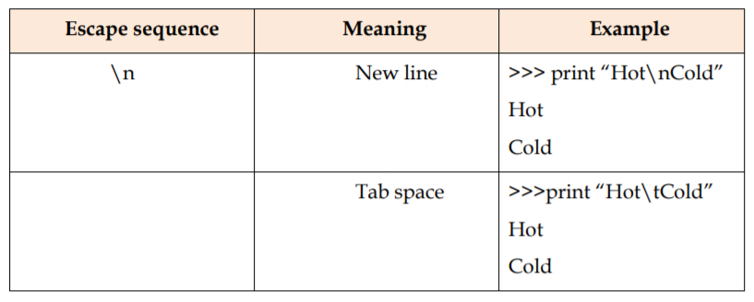

Slide 11
Strings are immutable
Strings are immutable means that the contents of the string cannot be changed after it is created.
Let us understand the concept of immutability with help of an example.
Example
>>>str='honesty‘
>>>str[2]='p‘
TypeError: 'str' object does not support item assignment
Python does not allow the programmer to change a character in a string. As shown in the above example, str has the value ‘honesty’. An attempt to replace ‘n’ in the string by ‘p’ displays a TypeError.

Slide 12
Traversing a string
Traversing a string means accessing all the elements of the string one after the other by using the subscript. A string can be traversed using: for loop or while loop.

Slide 13
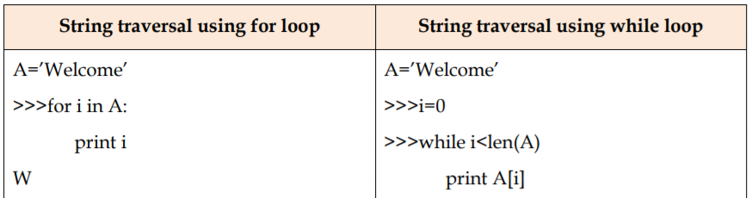
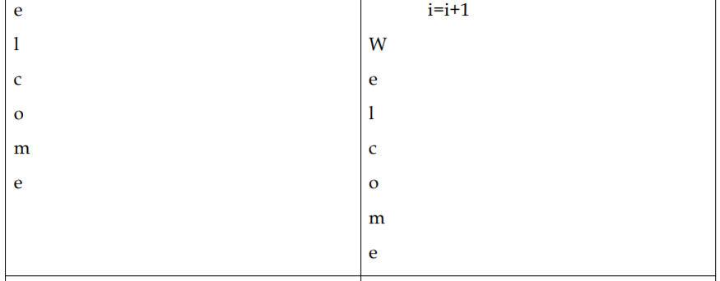

Slide 14
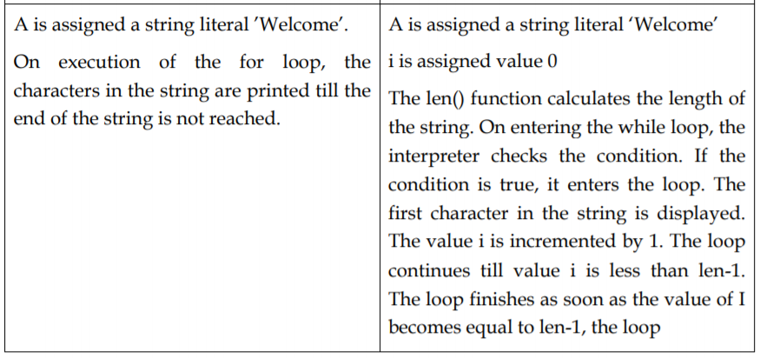

Slide 15
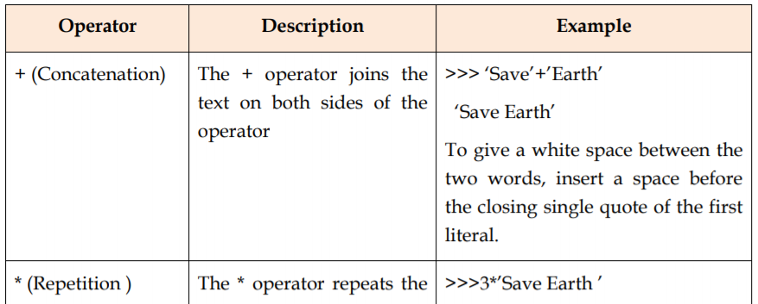
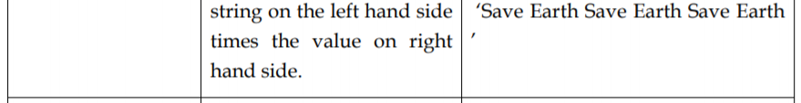
Strings Operations

Slide 16
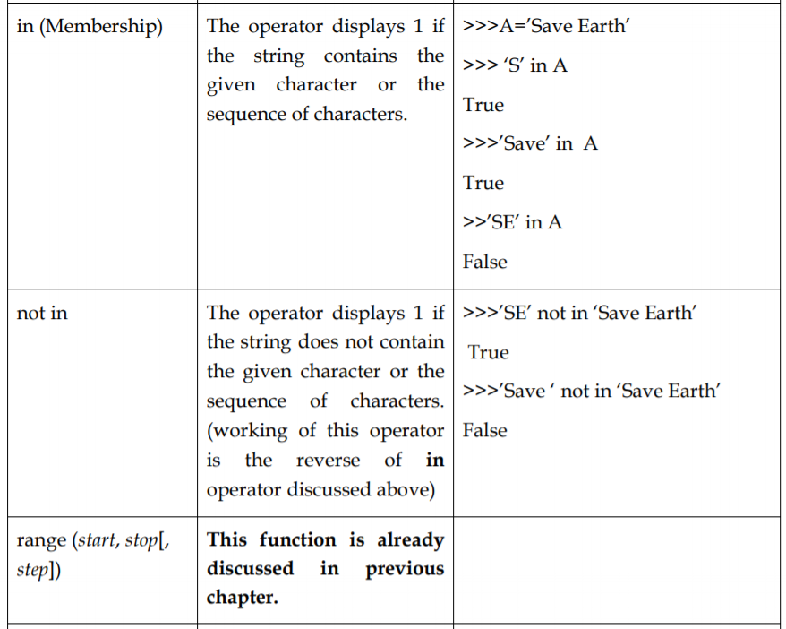

Slide 17
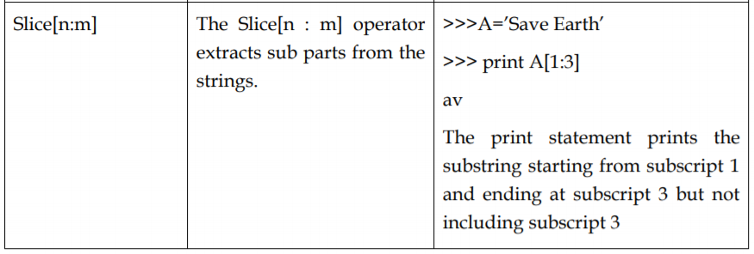

Slide 18
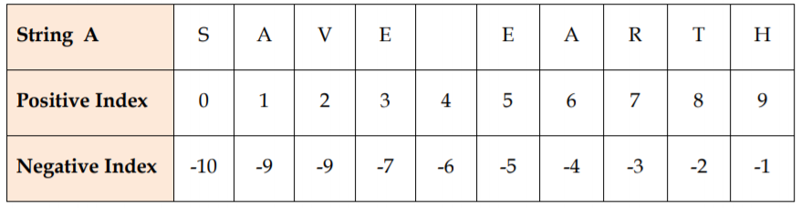
More on string Slicing
Consider the given figure

Slide 19
Let’s understand Slicing in strings with the help of few examples.
Example
>>>A=‟Save Earth”
>>> print (A[1:3])
av
The print statement prints the substring starting from subscript 1 and ending at subscript 3 .
Example
>>>print (A[3:])
‘e Earth’
Omitting the second index, directs the python interpreter to extract the substring till the end of the string

Slide 20
Example
>>>print (A[:3])
Sav
Omitting the first index, directs the python interpreter to extract the substring before the second index starting from the beginning.
Example
>>>print (A[:])
‘Save Earth’
Omitting both the indices, directs the python interpreter to extract the entire string starting from 0 till the last index

Slide 21
Example
>>>print (A[-2:])
‘th’
For negative indices the python interpreter counts from the right side (also shown above). So the last two letters are printed.
Example
>>>print (A[:-2])
‘Save Ear’
Omitting the first index, directs the python interpreter to start extracting the substring form the beginning. Since the negative index indicates slicing from the end of the string. So the entire string except the last two letters is printed.

Slide 22
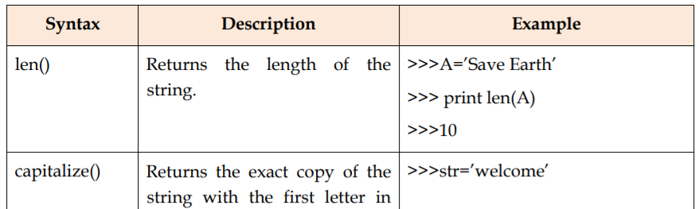
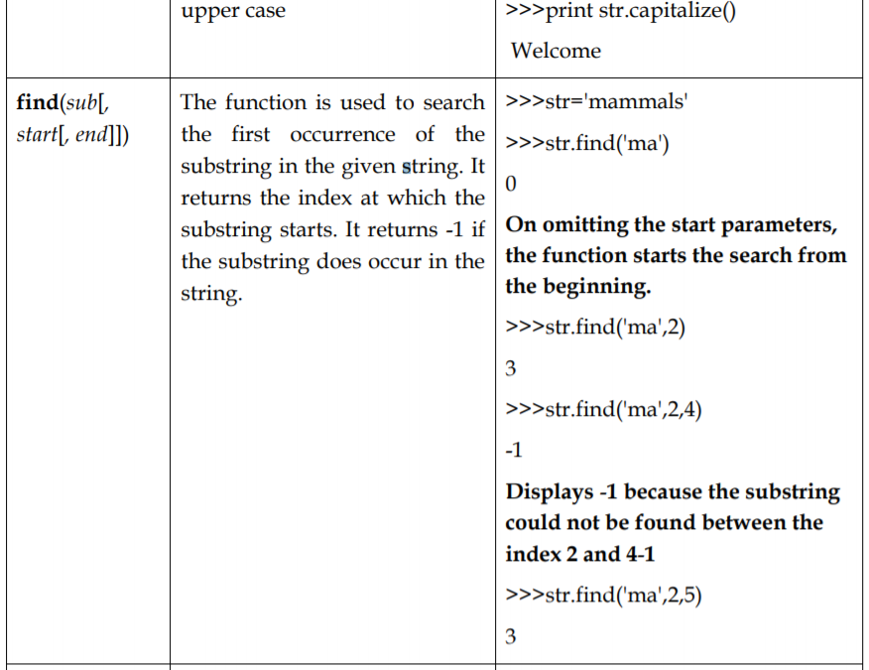
String methods & built in functions

Slide 23
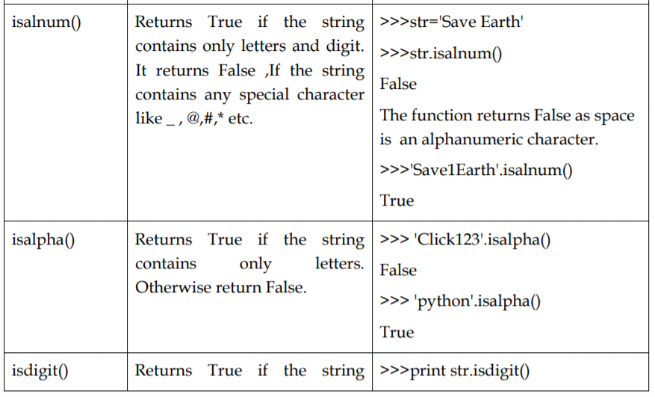

Slide 24
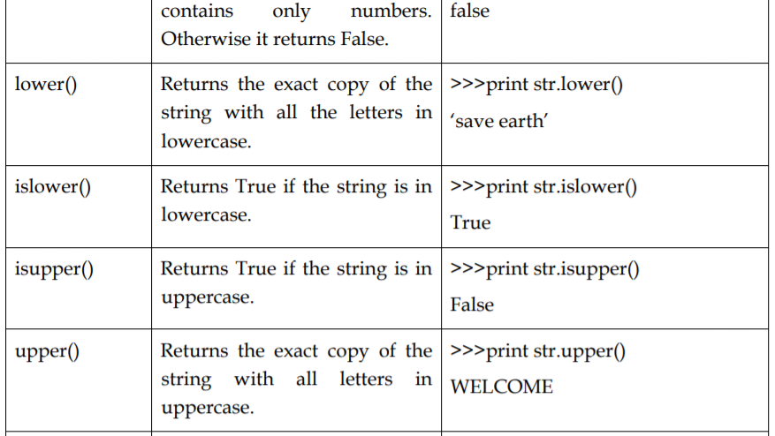

Slide 25
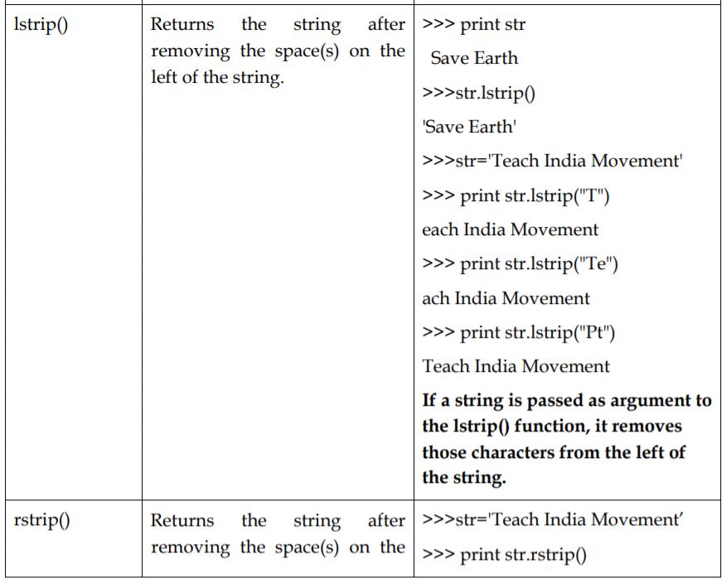

Slide 26
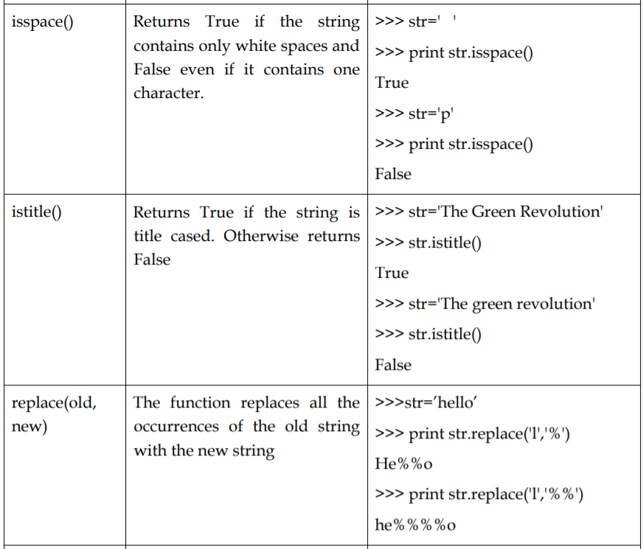

Slide 27
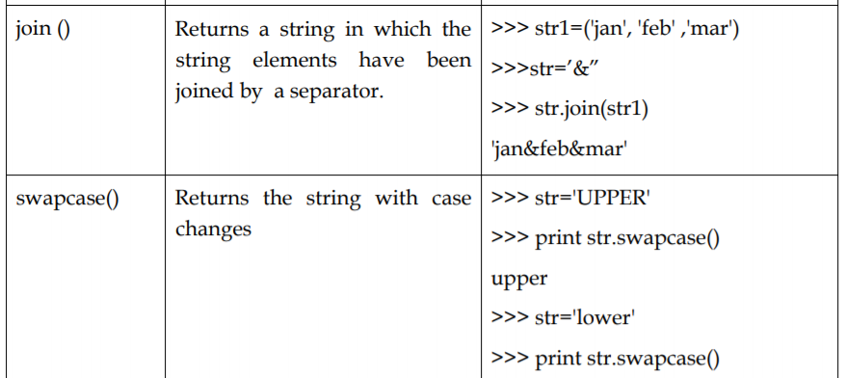

Slide 28
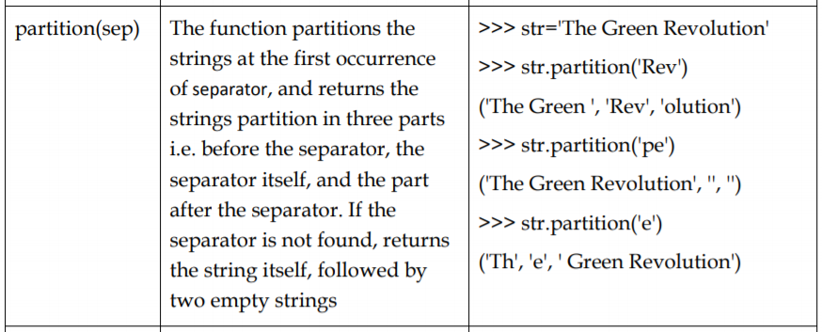

Slide 29
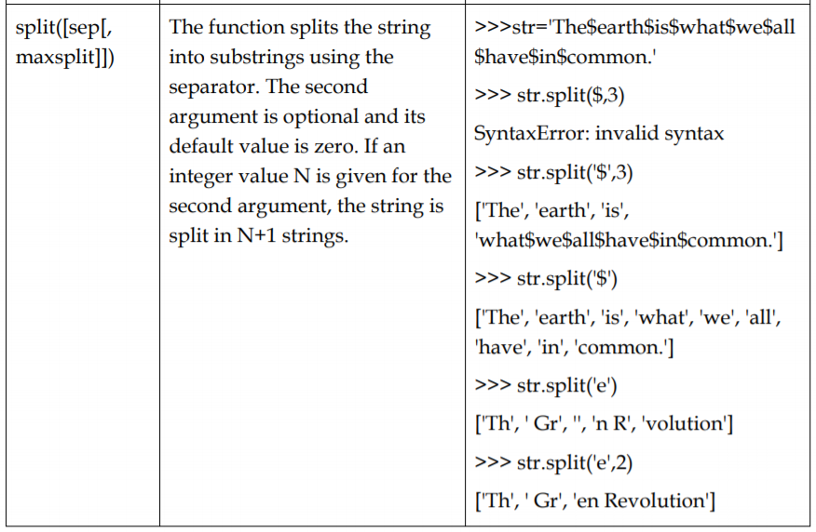

Slide 30
Note: In the table given above, len( ) is a built in function and so we don’t need import the string module. For all other functions import string statement is required for their successful execution.

Slide 31
Strings constants defined in string module:
string.ascii_uppercase
The command displays a string containing uppercase characters.
Example
>>> string.ascii_uppercase
'ABCDEFGHIJKLMNOPQRSTUVWXYZ'
string.ascii_lowercase
The command displays a string containing all lowercase characters.
Example
>>> string.ascii_lowercase
'abcdefghijklmnopqrstuvwxyz'

Slide 32
string.ascii_letters
The command displays a string containing both uppercase and lowercase characters.
>>> string.ascii_letters 'abcdefghijklmnopqrstuvwxyzABCDEFGHIJKLMNOPQRSTUVWXYZ‘
string.digits
The command displays a string containing digits.
>>> string.digits
'0123456789'

Slide 33
string.hexdigits
The command displays a string containing hexadecimal characters.
>>> string.hexdigits
'0123456789abcdefABCDEF‘
string.octdigits
The command displays a string containing octal characters.
>>> string.octdigits
'01234567'

Slide 34
string.punctuations
The command displays a string containing all the punctuation characters.
>>> string.punctuations
'!"#$%&\'()*+,-./:;<=>?@[\\]^_`{|}-‘
string.whitespace
The command displays a string containing all ASCII characters that are considered whitespace. This includes the characters space, tab, linefeed, return, formfeed, and vertical tab.
>>> string.whitespace
'\t\n\x0b\x0c\r '

Slide 35
string.printable
The command displays a string containing all characters which are considered printable like letters, digits, punctuations and whitespaces.
>>> string.printable
'0123456789abcdefghijklmnopqrstuvwxyzABCDEFGHIJKLMNOPQRSTUVWXYZ! "#$%&\'()*+,-./:;<=>?@[\\]^_`{|}- \t\n\r\x0b\x0c'

